Slide 1


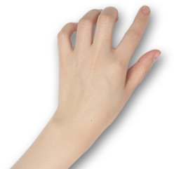

ASoC 2020 Final Report
Provide a separate tutorial for each Arthas command
Songlin Jiang
hollowman@hollowman.ml

Slide 2

1.Who am I
CATALOG
2.What did I do
3.My experience…

Slide 3
First
Who am I ?
Self-introduction

Slide 4
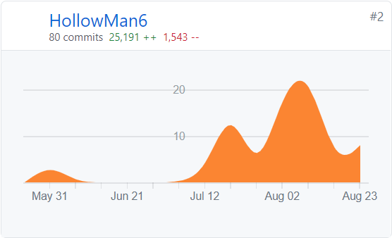


SELF-INTRODUCTION
Songlin Jiang
Lanzhou University
2018 Undergraduate majoring in CS
@HollowMan6
ASoC 2020 Arthas Community only successful Applicant
My Contributions
My Mentors
Chen Zhixuan
@hengyunabc
Gong Dewei
@kylixs
Alibaba Cloud Engineers, Arthas Developers

Slide 5
Second
What did I do?
Project Requirements
Design Concepts
Deliverables
Additional Achievements
Project Effect

Slide 6
PROJECT REQUIREMENTS
Move tutorial git Repository to Arthas itself
Seperate the tutorial, provide a separate tutorial for each Arthas command
Update the web page
Add links to the online tutorials for the official documents

Slide 7
DESIGN CONCEPTS
Design Concepts Abstract
1. Use real-world environment to learn and test new technologies in the browser to help developers learn and master best practices.
2. Solve the user's trouble of too troublesome to set up own environment, not having supported environment to try Arthas and the poor operability of the documents and the difficulty of hands-on practice.
Convenient
Straight-forward
Easy
Fast

Slide 8
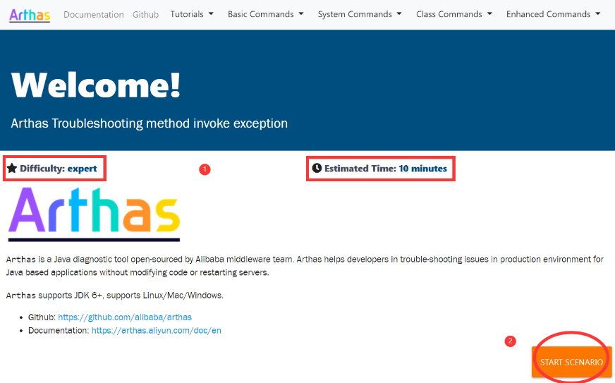
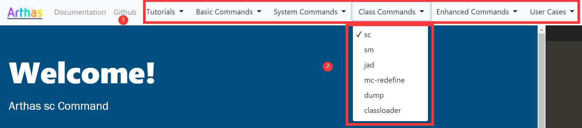
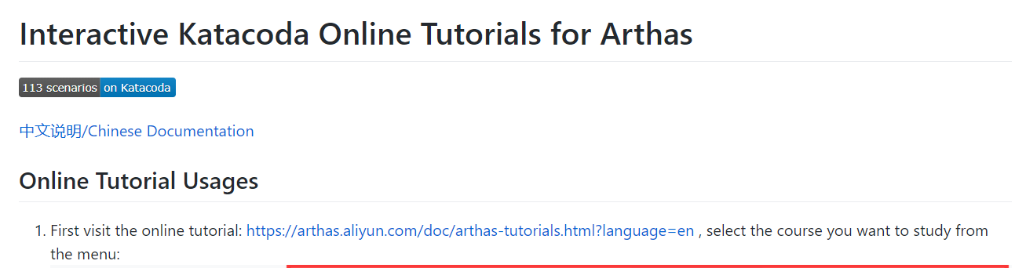
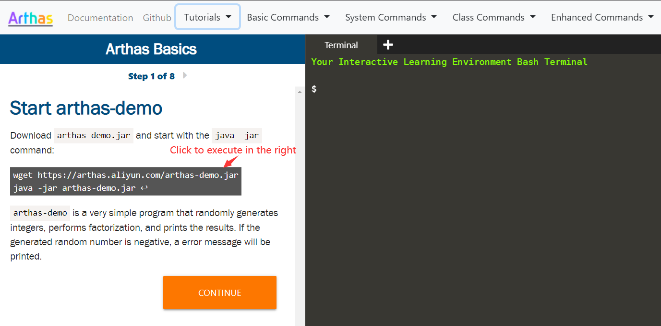
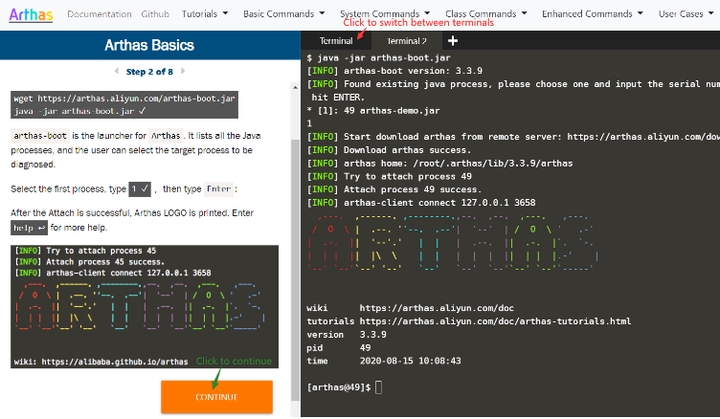
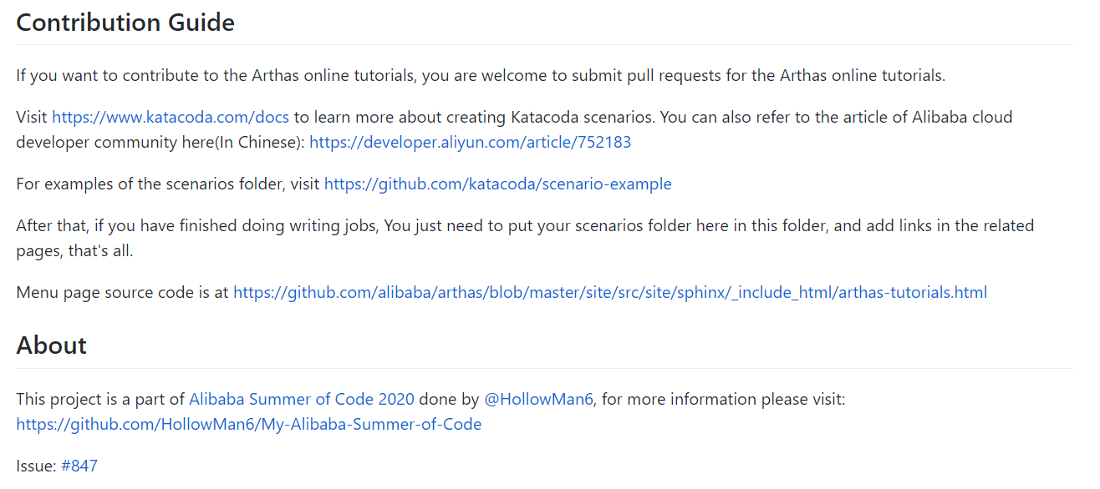
Deliverables
https://arthas.aliyun.com/doc/arthas-tutorials.html?language=en
Chinese + English Arthas Online Tutorial + User Cases

Slide 9
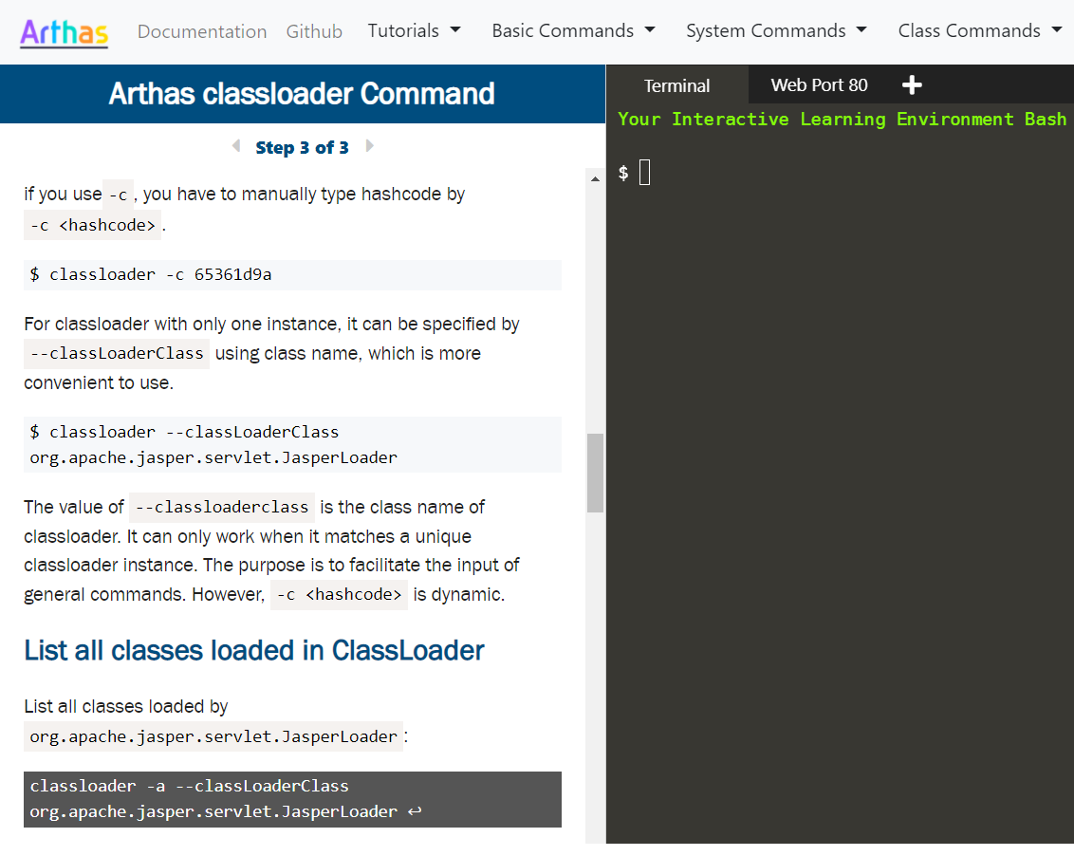
ADDITIONAL ACHIEVEMENTS
In addition to writing online tutorials for Arthas, I also actively improved the relevant commands, adding --classLoaderClass parameter to the classloader, sc, sm, logger, dump, getstatic, jad, mc, redefine commands, so that users can execute commands directly in the tutorial without manually entering the ClassLoaderHash value.

Slide 10
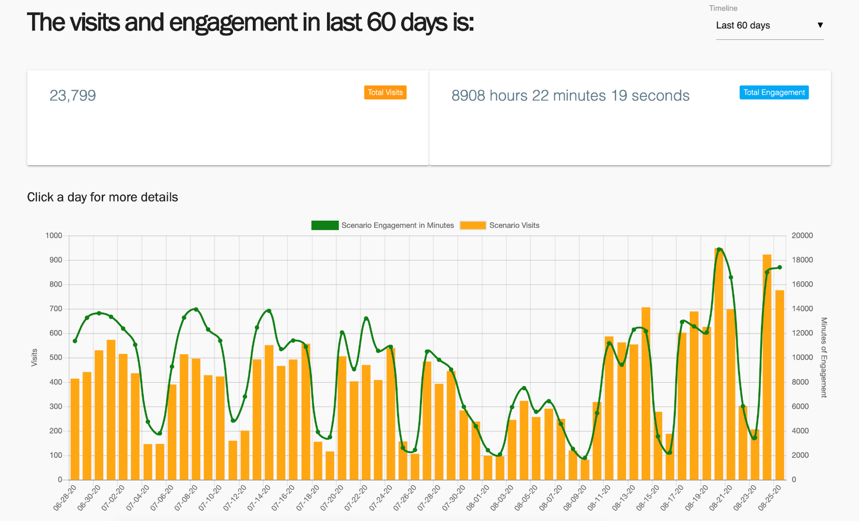
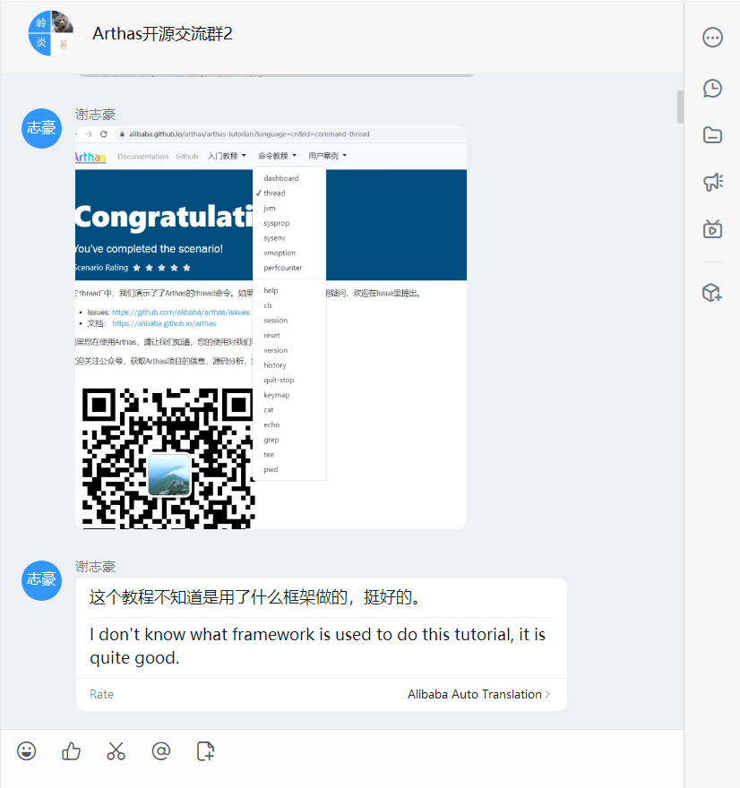
PROJECT EFFECT
Before July 31, more than half of commands and user tutorials had merged into the upstream. Since August 14, all command tutorials were completed and tested online.
During the test, the number of visits to the tutorial increased dramatically, and was well received by many users!
Statistics of the visit and engagement duration of the tutorials. It can be seen that after the new version of the tutorial test was launched on August 14, users and engagement duration have increased significantly.
Well received by users

Slide 11
Third
My experience…
Feelings

Slide 12

FEELINGS
Alibaba Summer of Code 2020 has greatly trained my team cooperation and communication skills, broadened my vision, and I gained a lot.
The two mentors also gave me a lot of guiding opinions.
if you have enough enthusiasm for open source, you are recommended to participate in the future Alibaba Summer of Code activities!

Slide 13


ASoC 2020 Final Report
THANKS!
Q&A

